Slide 1

Cybersecurity Case Studies

Slide 2
* Target, 2013
* Ashley Madison, 2015
* US Office of Personnel Management, 2015
* Equifax, 2017
* TikTok, 2020
* YouTube, 2020
* AOL, 2021

Slide 3
America Online
Yes, AOL is still a thing.
The company is synonymous with the early web. All people of a “certain age” will remember the AOL mailers with the disks that used up plastic at a rate that could only be accomplished in a pre-climate change zeitgeist.
At one time over HALF all CDs manufactured in the WORLD were for AOL.
It started out as a game downloading service for Atari. Yes, Steam/Epic for Atari. When that failed they reorged a couple times and became AOL in 1991 and was eventually acquired by Version for $4.4 BILLION in 2015.
Their heyday was between 1995 and 2001.

Slide 4
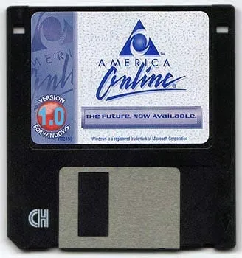
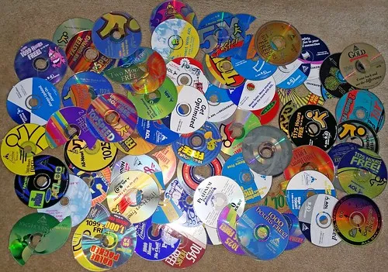
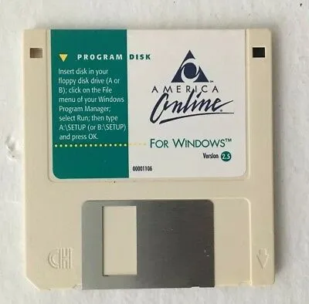
America Online
Yes, AOL is still a thing.
The company is synonymous with the early web. All people of a “certain age” will remember the AOL mailers with the disks that used up plastic at a rate that could only be accomplished in a pre-climate change zeitgeist.

Slide 5
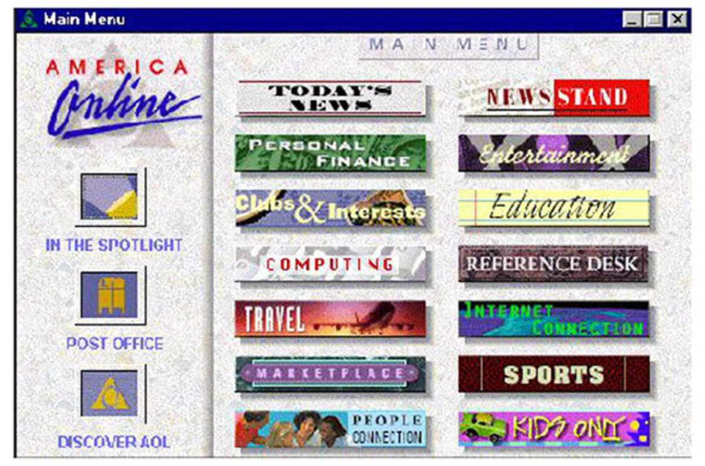

Slide 6
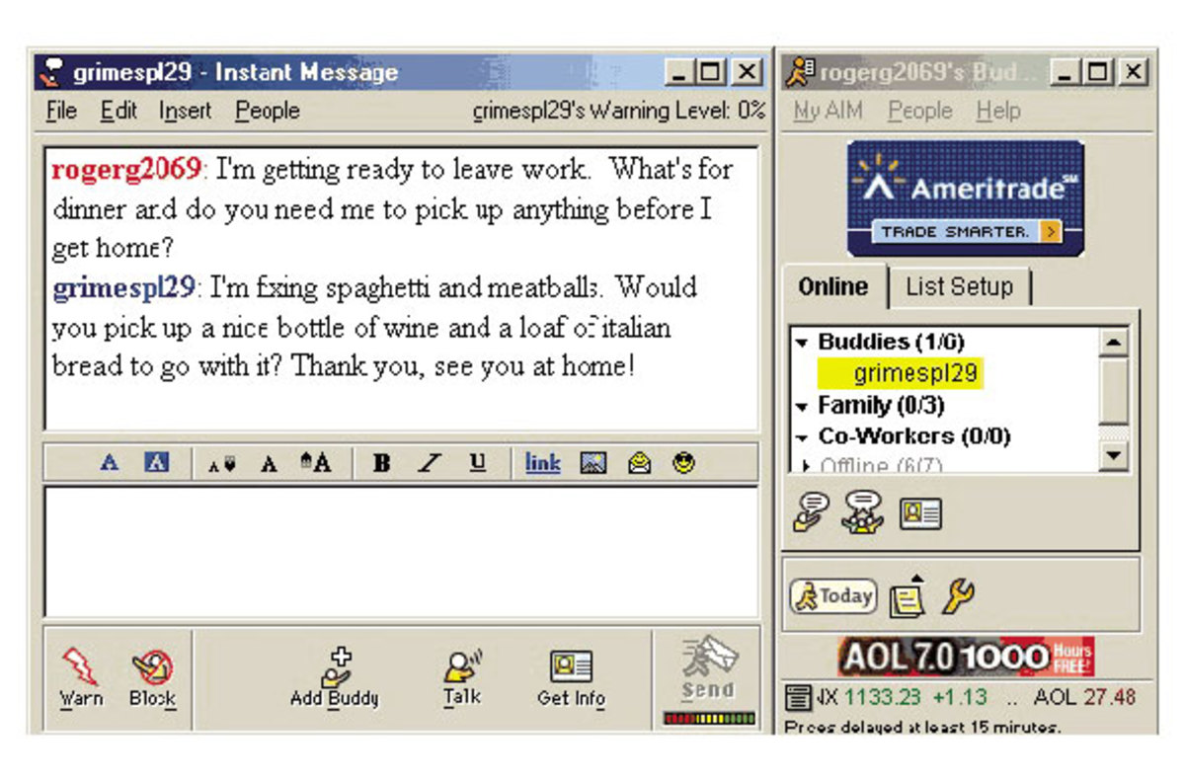

Slide 7
AOL eats the Internet
1998 – Bought CompuServe
1999 – Bought Netscape
2001 – Merged with Time Warner to create AOL Time Warner (AOLTW), the world’s largest media company at the time.
2003 – AOL quietly dropped from AOLTW and just became Time Warner again. Keep in mind that 2003 was at a time when it wasn’t great to be a media company OR an Internet company.
2004 – Bought Advertising.com
2006 - They finally stop mailing the damn CDs.
2009 – Unmerged with Time Warner.
2010 – Bought TechCrunch
2011 – Bought Huffington Post
2015 – Bought by Verizon.
2019 – Verizon mashes AOL and Yahoo! together to form Oath.
2020 – HuffPost sold to BuzzFeed.
2021 – Bought by Apollo

Slide 8
So what does Aol do now?
Man, I don’t even know, really…
They do content. Engadget, Autoblog, TechCrunch, Built by Girls
They do ads. The AOL toolbar was a thing until 2018. AIM was a thing until 2017. Now they do AOL desktop, an integrated browser, media player, and IM client.

Slide 9
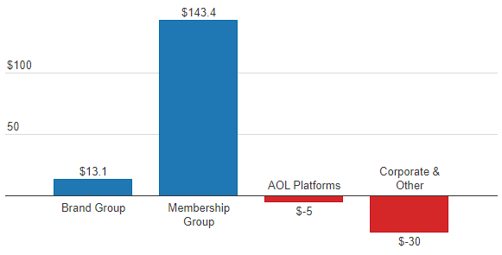
So what does Aol do now?
But they STILL make most of their money off subscribers… Dial-up Internet access –2.3 million people still use AOL's dial-up service (2019)

Slide 10
The breach(es)
Due tot heir long history in the Internet, it’s no surprise they have their share of breaches.
They had one in 2004 (92 M records), 2006 (20 M records) and 2014 (2.4 M records) – but this year they had one more when a disgruntled employee decided to do the needful.
Let’s look at the breaches in chronological order so see what happened in each.

Slide 11
2004 – The Dirty Deal
During the flagging years of its heyday a software engineer decided to make a little money on the side by selling a list of AOL customers to advertisers.
Jason Smathers to a Sean Dunaway for the promotion of his gambling business.
92 million records. AOL screen names, zip codes, telephone numbers, and credit card types. No PII. AOL only had 30 million subs at the time, so probably multiple accounts or records.
$28,000
Could have faces 5 years, $250,000 – but got 1.25 years and $84,000

Slide 12
2006 – the “oopsie”
TechCrunch (four years before AOL bought them) reports that AOL accidentally released a slew of private search data.
Referring to users by number, search engagement data is released. This doesn’t sound bad, but… the ability to analyze all searches by a single user will often lead people to easily determine who the user is, and what they are up to. The data includes personal names, addresses, social security numbers and everything else someone might type into a search box.
People often search on their own name, or those of their friends and family, to see what information is available about them on the net. Combine these ego searches with porn queries and you have a serious embarrassment. Combine them with “buy ecstasy” and you have evidence of a crime.

Slide 13
2014 – The steal
Over the course of several days, AOL security teams noticed a spike in spoofed emails from AOL addresses. These were being used to phish other users.
AOL said they did not think any information as actually breached, which implies a misconfiguration on their end to allow this. However, it also quickly became clear that wasn’t true either when CIA director John Brennan’s personal email address was confirmed to be leaked.

Slide 14
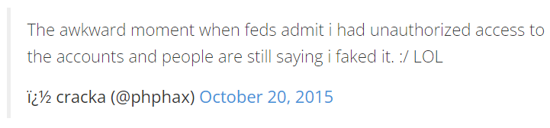
2014 – The steal
It turned out to be a case of hacktivism. Claiming responsibility in the attack was a “teen stoner” dissatisfied with US foreign policy. He said, on Brennan’s AOL account, he found 2,611 email and IM addresses – some for top national security officials, as well as more than 40 emails with attachments containing secret/top secret data.
He began to crank call these officials, including Brennan.

Slide 15
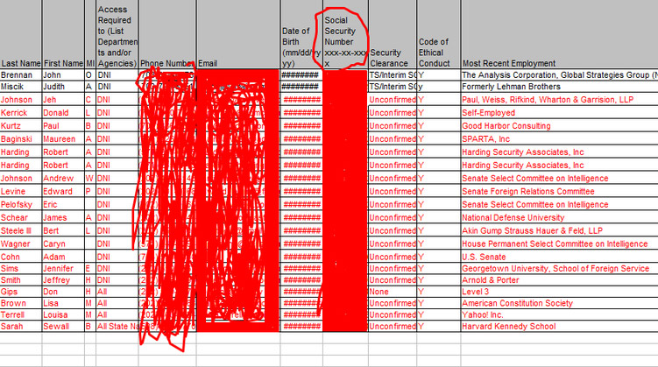

Slide 16
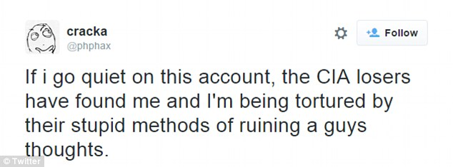
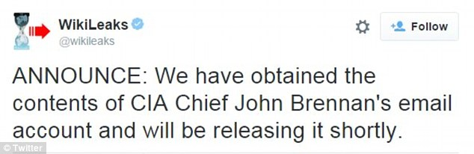
He was 13, btw.

Slide 17
2021 – le deluge
In 2021, AOL announced a surge in phishing attacks on their users.
Perceived to be an aging demographic, and ripe pickings for scammers.
Scams are changing all the time, but the key is generally to increase reward by reducing risk and lowering transaction cost. In short – you want to pick out the vulnerable.
The tactic can change… For younger demographics, offering a job or other carrot works best. For the older, confusing them with lingo and threatening to change things does the trick more often.
In this case – a campaign warning users that they were shutting down their old email service unless the customer upgraded to a new mailbox.

Slide 18
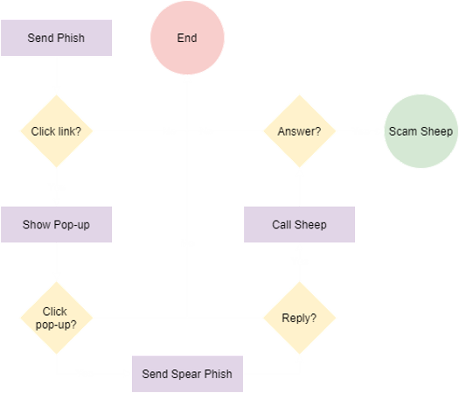

Slide 19
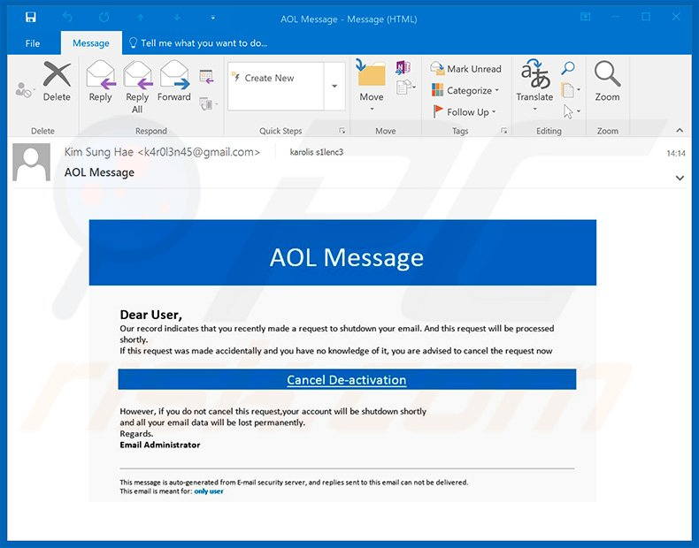

Slide 20
